Slide 1

CAR INSURANCE CLAIM PREDICTION
- A comprehensive model
- Janardhan Reddy Illuru
- Advanced Data Science and AI

Slide 2
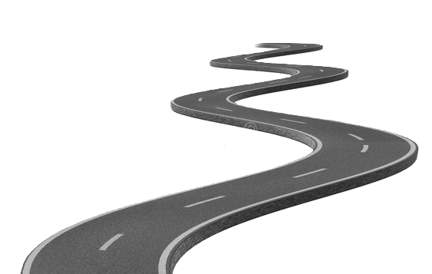

Table of contents:
1. Introduction
2. Exploring Dataset Details
3. Descriptive analysis
4. Insights into Customer Behaviour
5. Feature Engineering
6. Data Preparation
7. Building the Best Model
8. Conclusion

Slide 3

1. Introduction:
Objective:
The primary objective of this project is to develop a predictive model that accurately assesses the probability of insurance claims within a six-month period. By understanding the factors influencing claim frequency and severity, insurance companies can better evaluate risk and determine appropriate premiums for policyholders.
Importance:
In the competitive landscape of the insurance industry, accurately predicting claims is critical for maintaining profitability and customer satisfaction. Traditional methods often fall short in capturing the complex interactions between various factors that contribute to claims. Our predictive model aims to bridge this gap by leveraging advanced data analysis and machine learning techniques.

Slide 4
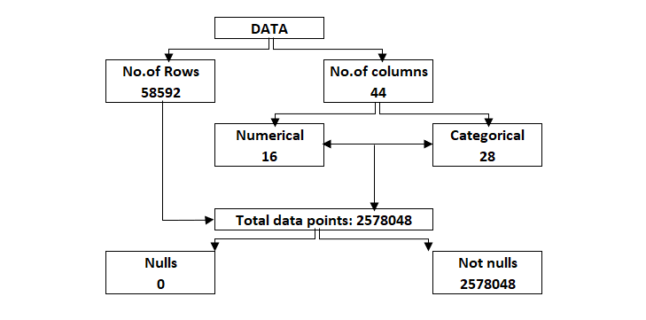
is_esc (Electronic Stability Control)
2. Exploring data details:
Policy and Demographics:
policy_id, policy_tenure, age_of_policyholder, area_cluster, population_density
Vehicle Specifications:
age_of_car, make, segment, model, fuel_type, max_torque, max_power, engine_type, airbags, rear_brakes_type, displacement, cylinder, transmission_type, gear_box, steering_type, turning_radius, length, width, height, gross_weight, ncap_rating
Features and Safety:
is_esc (Electronic Stability Control), is_adjustable_steering, is_tpms (Tire Pressure Monitoring System), is_parking_sensors, is_parking_camera, is_front_fog_lights, is_rear_window_wiper, is_rear_window_washer, is_rear_window_defogger, is_brake_assist, is_power_door_locks, is_central_locking, is_power_steering, is_driver_seat_height_adjustable, is_day_night_rear_view_mirror, is_ecw (Emergency Call Warning), is_speed_alert
Target Variable:
is_claim (Indicates if a claim was made)

Slide 5
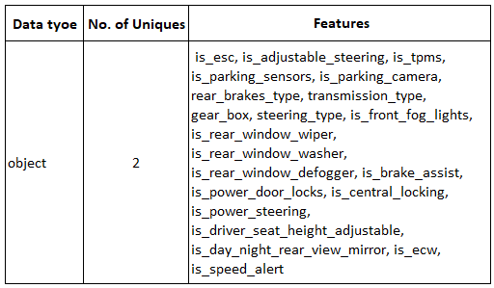
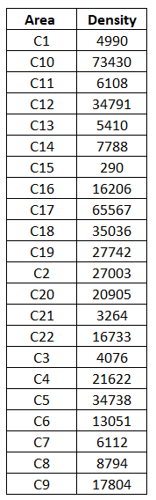
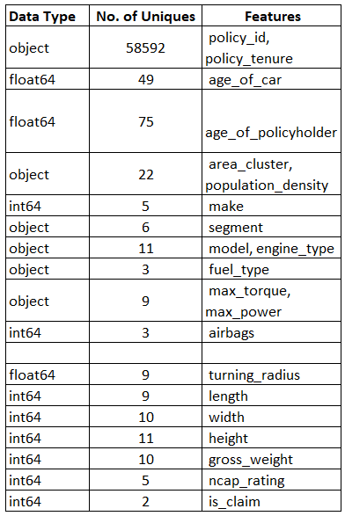
3. Descriptive analysis:
Most of the features contain Binary values yes/no and no null found in the data set.
interesting :
In our dataset, each unique area cluster corresponds uniquely to one population density value, resulting in 22 distinct combinations.

Slide 6
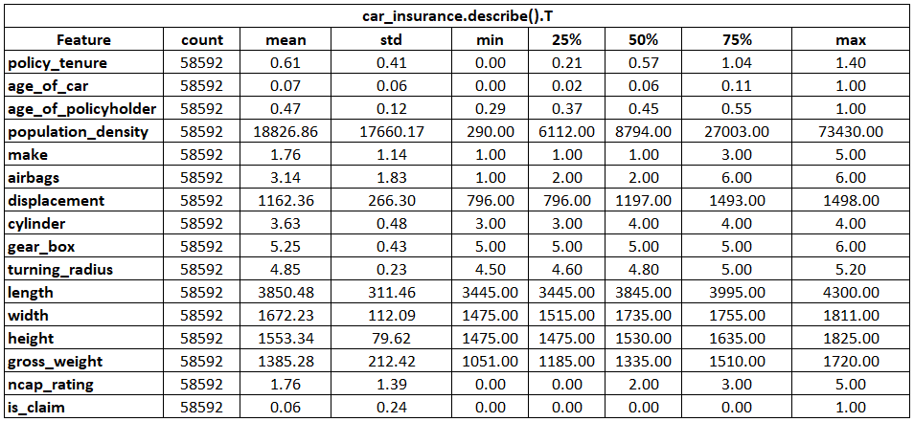
3. Descriptive analysis:
Policy Tenure: Ranges from 0.002735 to 1.396641, suggesting suitability for standard scaling.
Age of Car and Age of Policyholder: Already scaled between 0 and 1.
The mean values closely align with the 50th percentile (median), indicating minimal influence from outliers across all features.

Slide 7
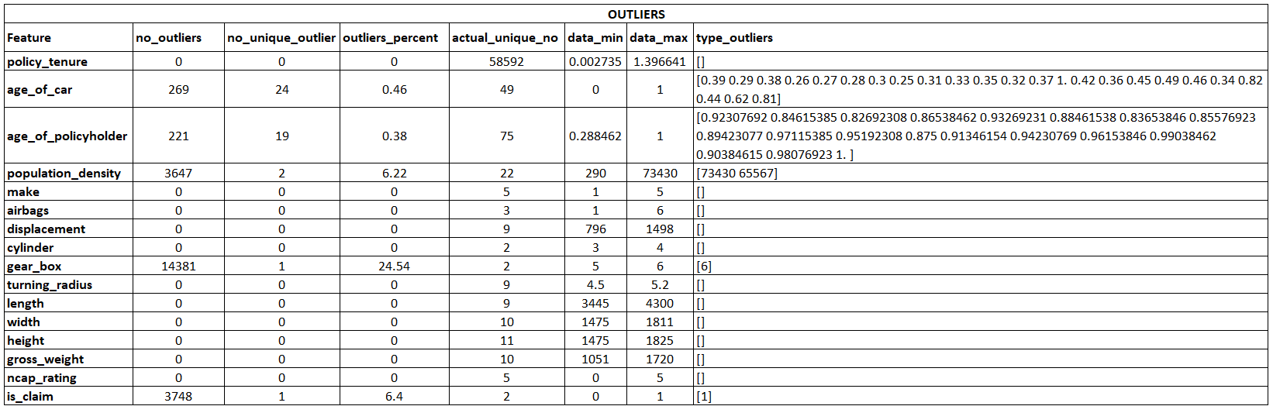
3. Descriptive analysis:
We can clearly observe that there is no much effect of outliers on the data.
The "gear_type" column only contains values of 5 and 6, but 6 is identified as an outlier, leading to a reported outlier percentage of 24.54%. However, these values are not anomalies but rather distinct categories within the data.
Population density shows outliers amounting to 6.22%, represented by values 73430 and 65567, corresponding to area clusters C10 and C17, respectively. Given that population density naturally varies by area, and each density value aligns with a specific area cluster, these outliers are valid and do not adversely affect the analysis. Outliers in other columns are negligible.

Slide 8
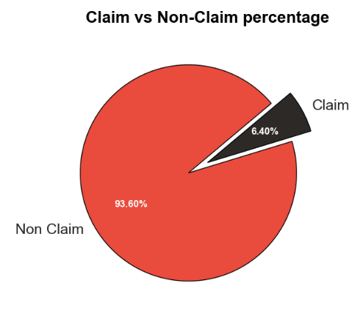
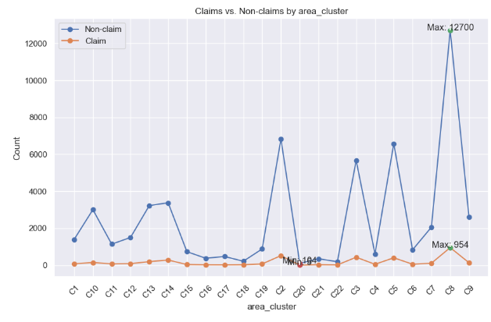
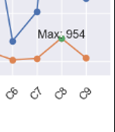
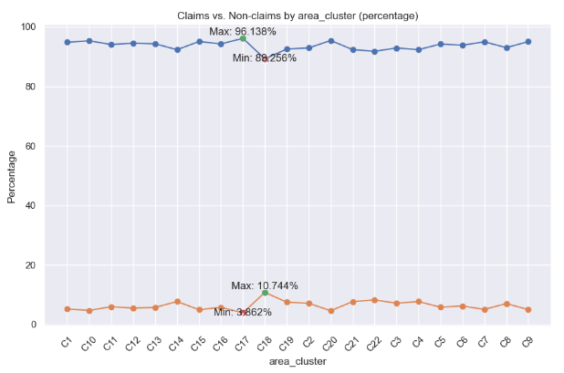
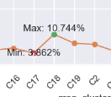
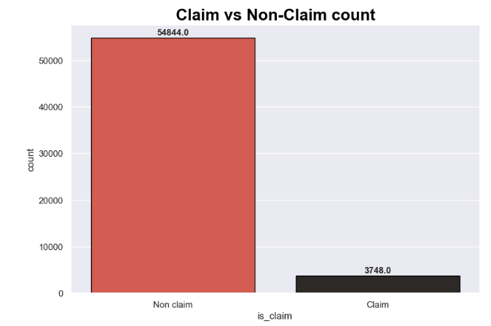
4. Insights and Customer behavior:
Feature vs. Claim Counts
Feature vs. Claim Percentage
Feature | Min/Max Claim Count | Min/Max Relative %
Area Cluster | ▲ C8 | ▲ C18
Segment | ▲ B2 | ▲ B2
Model | ▼ M11 | ▼ M11
Max Torque | ▼ 170Nm@4000rpm | ▼ 170Nm@4000rpm
Max Power | ▼ 118.36bhp@5500rpm | ▼ 118.36bhp@5500rpm
Engine Type | ▼ 1.5 Turbocharged Revotron | ▼ 1.5 Turbocharged Revotron
Fuel Type | ▲ Petrol | ▲ Petrol
Steering Type | ▼ Manual | ▼ Manual
The dataset shows a significant imbalance, with only 6.40% of individuals making insurance claims.

Slide 9
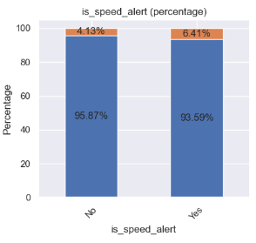
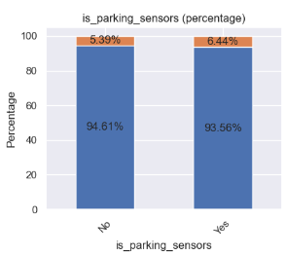
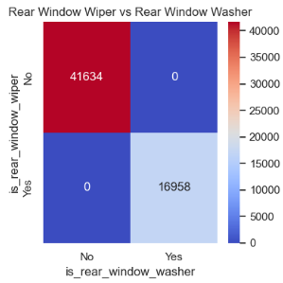
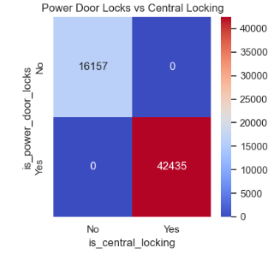
4. Insights and Customer behavior:
General Effect: Most binary features and NCAP rating have similar impacts on insurance claims. (~6 ± 0.5%).
Distinct Impact: "Speed alert" (4.13% & 6.41% )and "parking sensors" (5.39% & 6.44%) uniquely influence claim frequencies, suggesting a significant role in claim likelihood.
Mutually Exclusive Pairs:
Window Washer and Window Wiper
Central Locking System and Power Door Locking System
Each pair exhibits mutual exclusivity, where the presence of one feature implies the presence of the other. This redundancy allows us to consider either feature from each pair for model training and avoiding duplicated information.

Slide 10

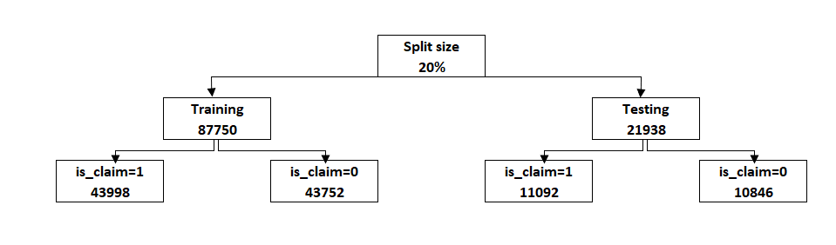
5. Feature Engineering:
We created a feature called "unit_weight" using the length, width, height, and gross weight of the car. This new feature effectively represents the combined information of these four attributes.
We dropped the following columns:
"policy_id" is a unique identifier.
"length", "width", "height", and "gross_weight" are now represented by the "unit_weight" feature.
is_rear_window_wiper" and "is_power_door_locks" have their mutually exclusive counterparts: "is_rear_window_washer" and "is_central_locking", respectively, so we selected one from each pair.
"area_cluster" is represented by "population_density".
We changed the data type of "make", "airbags", "cylinder", "gear_box", and "ncap_rating" to object, as
these are categorical values that were previously defined as integers.

Slide 11
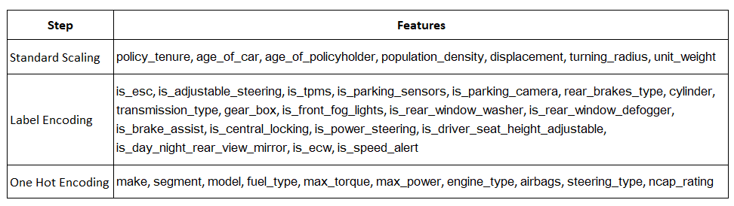
6. Data Preparation:
Feature Transformation and Encoding:
Correlation:
Most correlations are below 0.05 with p-values also below 0.05, indicating weak linear relationships. Considering dropping features would leave only 5 to 6 which will oversimplify the data and our understandings. So, we didn’t made any conclusions from correlation.
Balancing Data Using SMOTE Technique :
As a result of applying the SMOTE technique, the dataset now has equal number of instances for each class label (“is_claim”): 54,844 instance labelled as 0 and 54,844 instances labelled as 1.

Slide 12
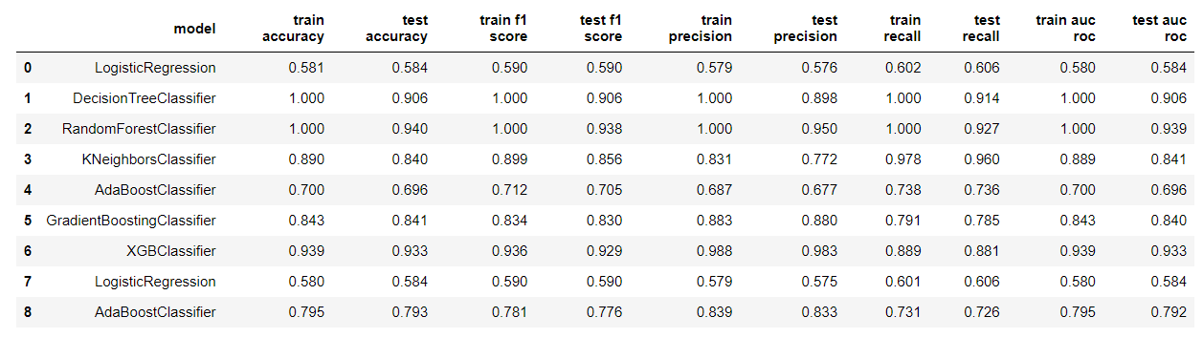
7. Building Best Model:
Logistic Regression shows consistent but low performance across both train and test sets, indicating limited predictive power on this dataset.
Decision Tree shows perfect performance on the training set but a significant drop on the test set, indicating overfitting.
Random Forest also shows perfect training performance but better generalization than the Decision Tree, indicating strong predictive power with some overfitting.
KNN shows good training performance but lower test performance, suggesting moderate overfitting.
AdaBoost shows moderate performance with consistent results across training and testing sets.
Gradient Boosting shows strong performance with good generalization, indicating robust predictive power.
XGBoost shows excellent performance with strong generalization.
Tunned Logistic Regression shows similar performance to the first instance of Logistic Regression.
Tunned AdaBoost shows better performance than the first instance, with consistent results across training and testing sets.

Slide 13

8. Conclusion:
CONCLUSION:
Best Performing Model: XGBoost Classifier stands out as the best performing model with the highest test accuracy (0.933) and test AUC-ROC (0.933), indicating strong predictive power and generalization with minimal overfitting.
Runner-Up Models: Random Forest Classifier and Gradient Boosting Classifier also perform well, with Random Forest showing slight overfitting and Gradient Boosting demonstrating robust performance.
Overfitting Concern: Decision Tree Classifier exhibits significant overfitting, as indicated by its perfect training metrics but much lower test metrics.
Consistent but Low Performance: Logistic Regression consistently shows low performance, suggesting it may not be well-suited for this dataset.
Moderate Performance: AdaBoost and KNN classifiers provide moderate performance with relatively consistent training and test metrics.

